Slide 1



Median of Two Sorted Arrays
The problem of finding the median of two sorted arrays is a classic coding challenge that tests your ability to think algorithmically and efficiently. It's a fundamental problem with applications in data analysis, signal processing, and many other domains.

Slide 2

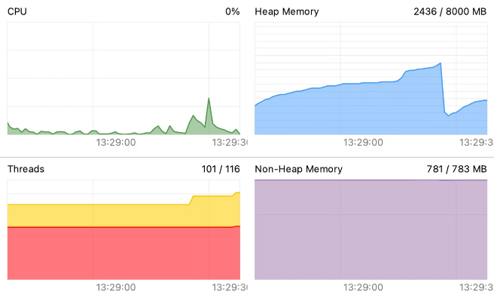
Space Complexity Analysis
Space Complexity
Explanation
The space complexity of the solution is O(1), which means it uses a constant amount of extra space, regardless of the input size.
The solution only uses a few variables to keep track of the partition points and the median calculation, and does not require any additional data structures that scale with the input size.
Comparison
Significance
This is an optimal space complexity, making the solution memory-efficient and suitable for handling large datasets.
The constant space complexity ensures that the solution can be used in resource-constrained environments, such as embedded systems or mobile devices.

Slide 3

Problem Statement
1
Given
2
Task
3
Constraints
Two sorted arrays, A and B, of potentially different lengths.
Find the median of the combined, sorted array of A and B.
The solution must have a time complexity of O(log(m+n)), where m and n are the lengths of A and B, respectively.

Slide 4

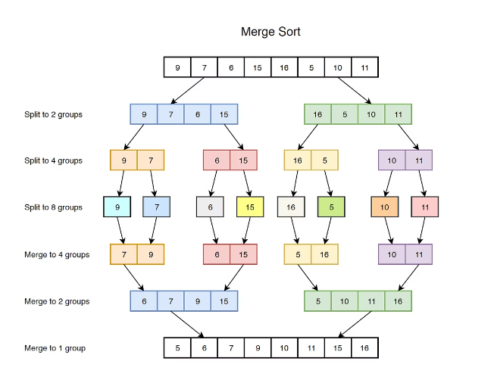
Approach: Divide and Conquer
1
1. Partitioning
Divide the arrays into two halves, such that the elements in the left half are smaller than the elements in the right half.
2
2. Comparison
Compare the partitions to find the median, adjusting the partition points as needed.
3
3. Recursion
Recursively apply the partitioning and comparison steps until the median is found.

Slide 5
Implementing the Solution in C
Function Prototype
Key Steps
Sample Implementation
double findMedianSortedArrays(int* nums1, int nums1Size, int* nums2, int nums2Size);
Determine the smaller array and the larger array.
// C code implementation details...
Perform binary search on the smaller array to find the partition points.
Calculate the median using the partition points.

Slide 6
Code and Output

Slide 7

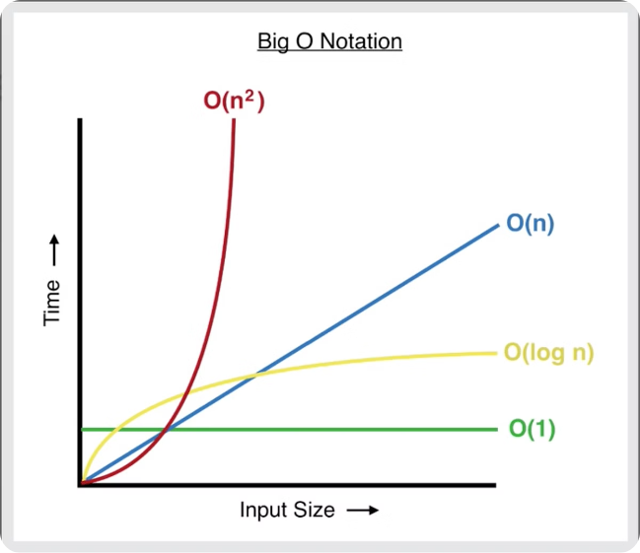
Time Complexity Analysis
Optimal Time Complexity
Explanation
The optimal time complexity for this problem is O(log(m+n)), where m and n are the lengths of the input arrays.
The divide and conquer approach, using binary search, allows us to reduce the search space by half in each iteration, leading to a logarithmic time complexity.
Comparison
Significance
This is significantly better than the naive approach, which would have a time complexity of O(m+n).
The optimal time complexity makes this solution efficient and scalable, even for large input sizes.

Slide 8


Edge Cases and Handling
1
Empty Arrays
2
Single Element Arrays
The solution should handle the case where one or both of the input arrays are empty.
The solution should correctly handle the case where one or both of the input arrays have only one element.
3
Array Size Differences
4
Overflow Handling
The solution should work correctly even when the input arrays have significantly different sizes.
The solution should ensure that intermediate calculations do not overflow, especially when dealing with large input values.

Slide 9
Optimizations and Improvements
Optimization Techniques
Potential Improvements
Future Enhancements
Implement an iterative version of the algorithm instead of a recursive one.
Extend the solution to handle more than two input arrays.
As technology advances, there may be opportunities to leverage new hardware or software capabilities to further optimize the solution and make it even more efficient and scalable.
Explore parallel or distributed computing approaches to further improve performance.
Optimize the binary search implementation for better performance.
Investigate the use of specialized hardware, such as GPU acceleration, to speed up the calculations.
Explore techniques to reduce the number of comparisons required.

Slide 10
Comparison with Other Techniques
Brute Force Approach
Heap-based Approach
Advantages of Divide and Conquer
A simple brute force approach would have a time complexity of O(m+n), which is less efficient than the divide and conquer solution.
Using a min-heap and a max-heap to maintain the merged array would have a time complexity of O(log(m+n)) for finding the median, which is comparable to the divide and conquer solution.
The divide and conquer approach is more efficient, requiring fewer comparisons and having a better time complexity, making it the preferred solution for this problem.

Slide 11





Conclusion and Key Takeaways
Algorithmic Thinking
Optimization
Edge Case Handling
Continuous Learning
Mastering the ability to think algorithmically and apply divide and conquer techniques is crucial for solving complex coding problems efficiently.
Continuously seeking ways to optimize a solution, both in terms of time and space complexity, is essential for building high-performance systems.
Anticipating and handling edge cases is a vital part of developing robust and reliable solutions that can handle a wide range of inputs.
Staying updated with the latest algorithmic techniques and exploring new approaches is key to becoming a skilled problem-solver.

